Slide 1
The Constitutional Convention
Jon Hale
College of Charleston

Slide 2
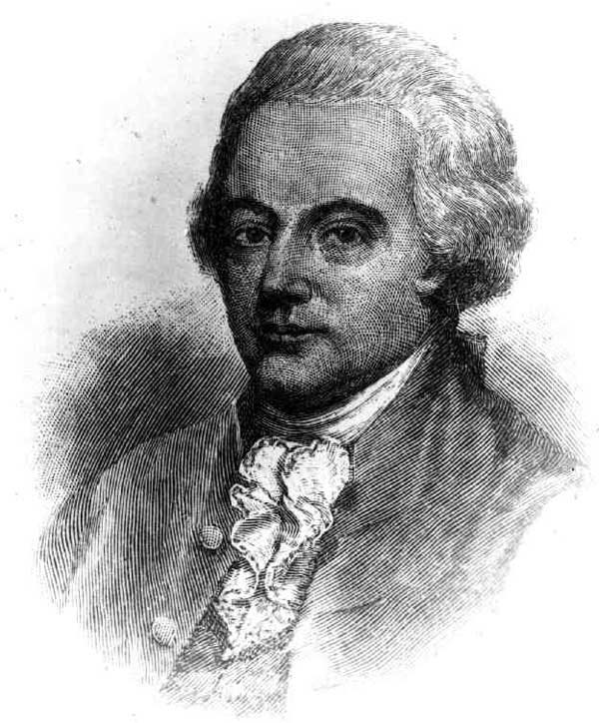
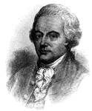

Slide 3
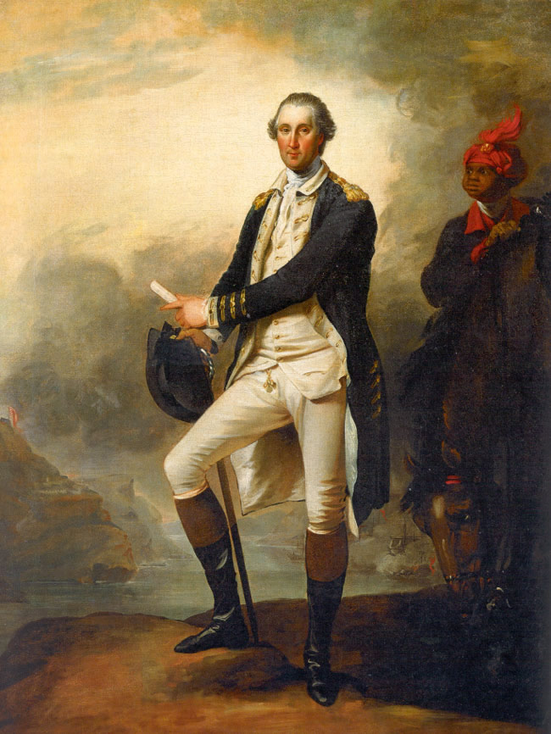

Slide 4
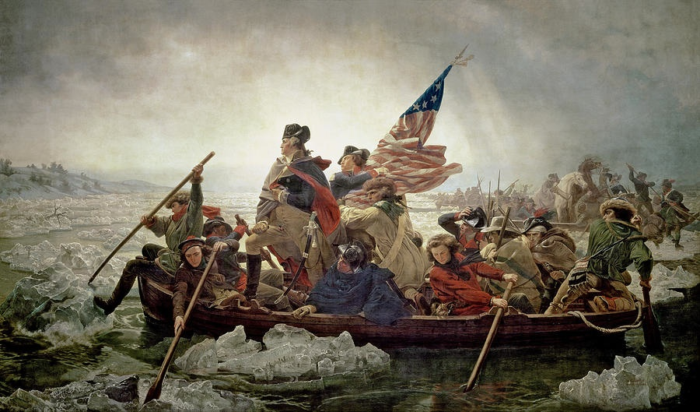

Slide 5
“It would be a strange thing if Six Nations of ignorant savages should be capable of forming a scheme for such an union, and be able to execute it in such a manner as that it has subsisted ages and appears indissoluble; and yet that a like union should be impracticable for ten or a dozen English colonies.”
-- Benjamin Franklin (1851) Benjamin Franklin to James Parker, March 20, 1751, Papers of Benjamin Franklin, vol. 3, Jan. 2, 1745-June 30, 1750. ed. by Leonard Labaree et al. New Haven: Yale University Press, 1962.

