Slide 1
Populism, Progressivism, The New Deal, and the Second World War
Jon Hale
College of Charleston

Slide 2
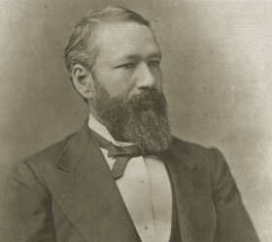
Jim Crow and “Progressivism”
“The object of the amendment was undoubtedly to enforce the absolute equality of the two races before the law, but in the nature of things it could not have been intended to abolish distinctions based upon color, or to enforce social, as distinguished from political equality”
- Plessy v. Ferguson (1896)

Slide 3
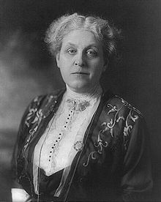
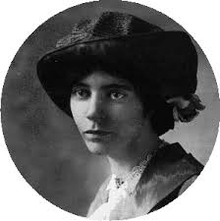
Women’s Suffrage
Carrie Chapman Catt (1859-1947)
National American Woman Suffrage Association (NAWSA)
Alice Paul (1885-1977)
National Women’s Party (1917)
More radical strategies

Slide 4
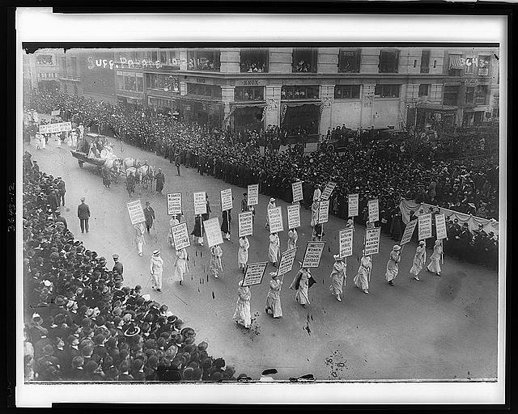

Slide 5
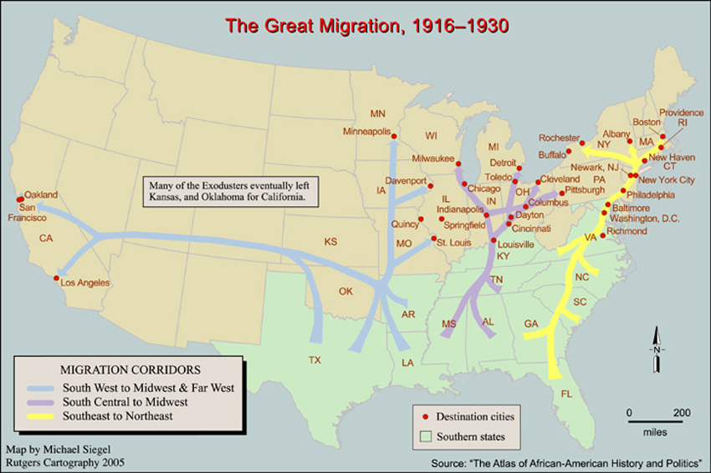

Slide 6
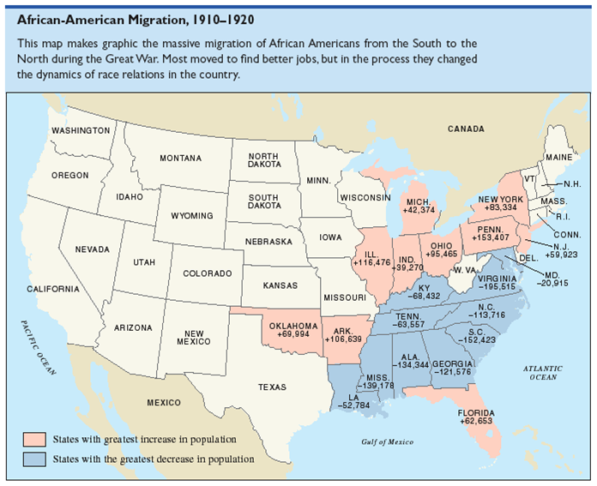

Slide 7
FDR Inaugural Address
“Our Constitution is so simple and practical that it is possible always to meet extraordinary needs by changes in emphasis and arrangement without loss of essential form. That is why our constitutional system has proved itself the most superbly enduring political mechanism the modern world has produced. It has met every stress of vast expansion of territory, of foreign wars, of bitter internal strife, of world relations.”

Slide 8
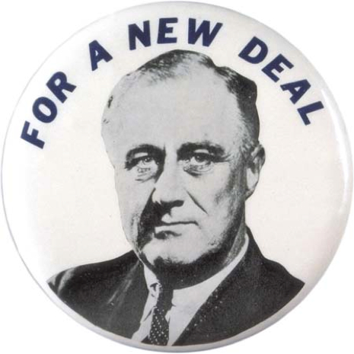
The New Deal
“I shall ask the Congress for the one remaining instrument to meet the crisis -- broad Executive power to wage a war against the emergency, as great as the power that would be given to me if we were in fact invaded by a foreign foe.”

Slide 9
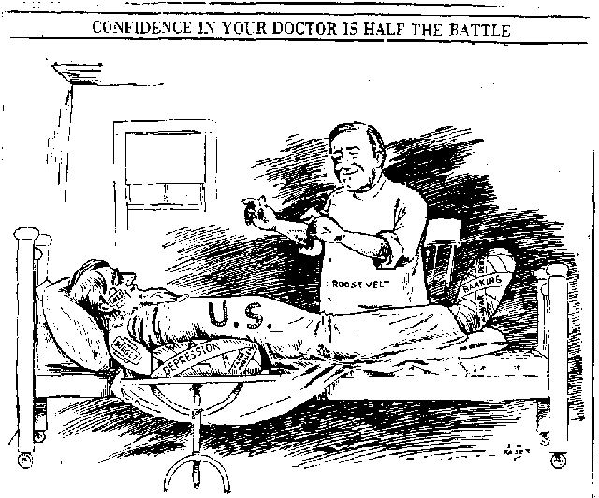

Slide 10
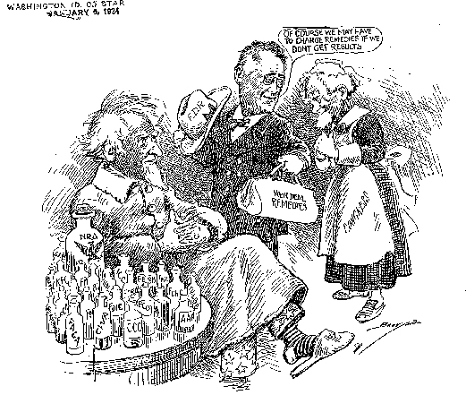

Slide 12
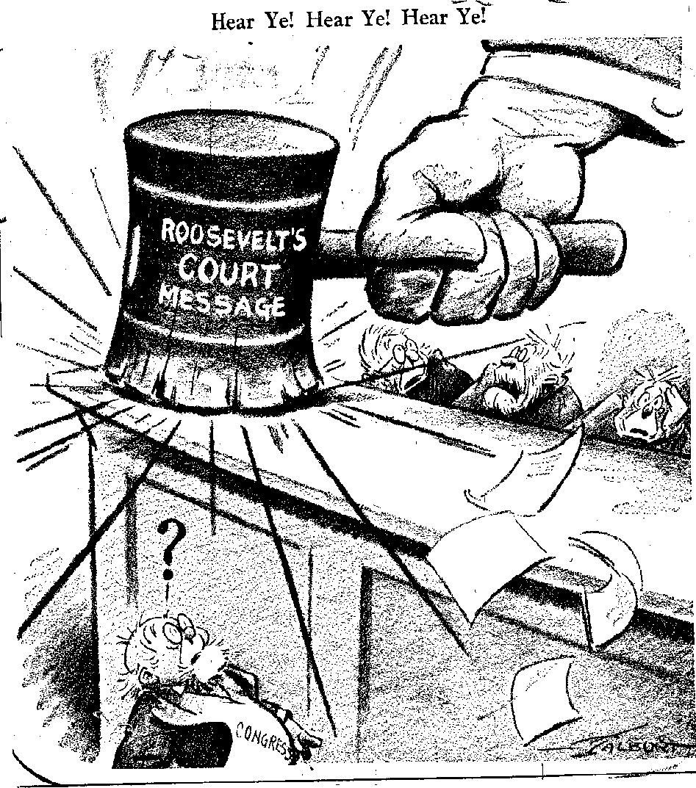

Slide 13
Huey Long “Share Our Wealth”
1. To limit poverty by providing that every deserving family would share in the wealth of America.
2. To limit fortunes to a few million dollars so that the rest of the American people could share in the wealth and profits of the land.
3. To provide old-age pensions to persons over 60 who did not earn over a certain amount, or who possessed less than $10,000 in cash or property.
4. To limit the hours of work to such a degree that overproduction could be prevented, and workers could enjoy some of the recreations, conveniences, and luxuries of life.
5. To balance agricultural production with what could be sold and consumed. [*To balance the problem of unemployment caused by limited agricultural production, farmers would complete public works projects during times when they were not required to produce farm products.]
6. To care for the veterans of our wars.
7. To acquire the tax dollars for running the government by reducing big fortunes.

Slide 14
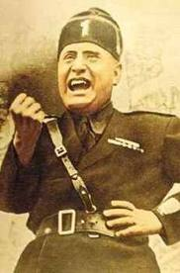
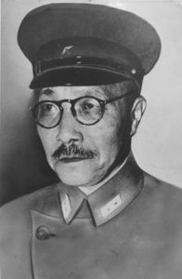
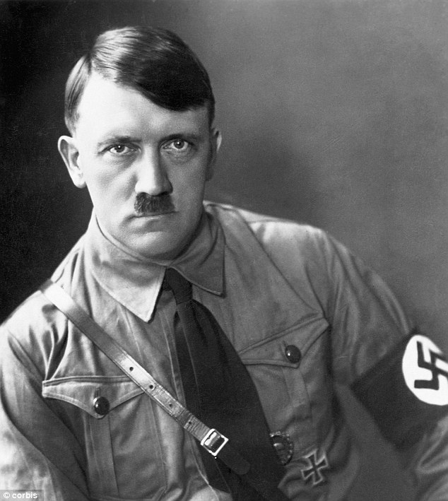
Axis Powers

Slide 15
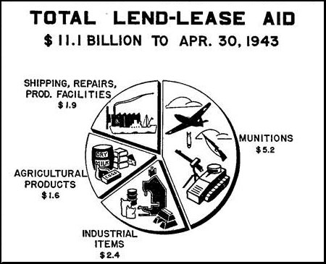

Slide 16
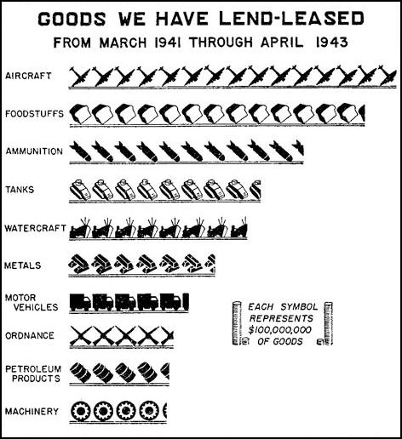

Slide 17
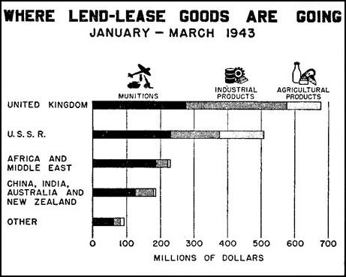

Slide 18
