Slide 1
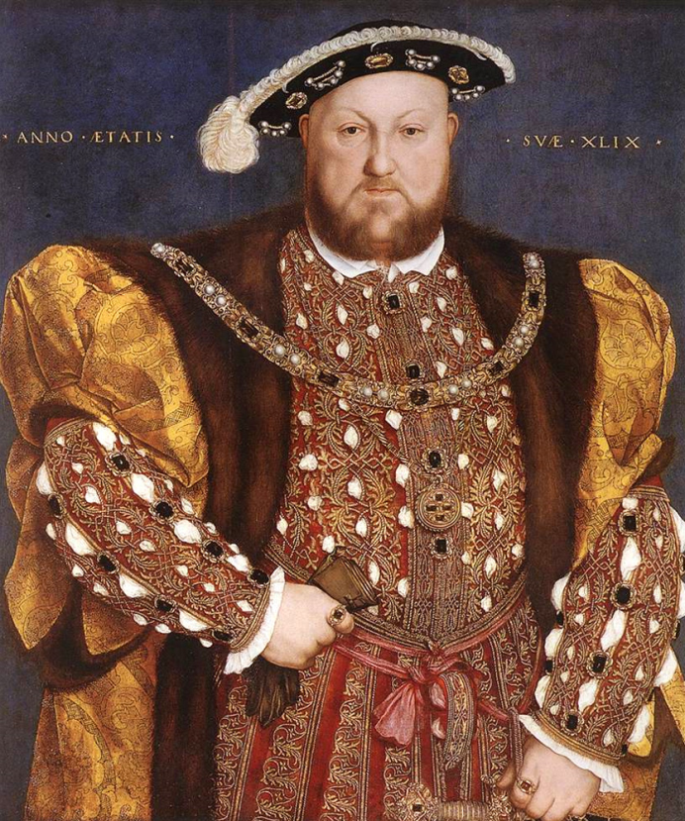
Henry VIII: A “Good” Catholic?

Slide 2
Henry’s Roman Catholic Credentials
Henry VIII’s military campaigns began when he joined Pope Julius II’s Holy League against France in 1511.
Chief advisors were first Chancellor Warham, Archbishop of Canterbury and Lord Chancellor of England; Richard Fox, Bishop of Winchester and Lord Privy Seal; and later Thomas Wolsey, Archbishop of York
Fidei defensor (Defender of the Faith) was a title given to Henry VIII by Pope Leo X in 1521 after the publication of Henry’s Defense of the Seven Sacraments
Henry & Catherine of Aragon went on numerous pilgrimages

Slide 3
Matter of Conscience?
On 22 June 1527 Henry VIII confessed to Catherine of Aragon that his conscience was troubled over the legitimacy of their marriage and was seeking an annulment on grounds of consanguinity
Leviticus 20:21: “And if a man shall take his brother’s wife, it is an unclean thing: he hath uncovered his brother’s nakedness; they shall be childless.”
Deuteronomy 11: 26 - 28: “I set before you this day a blessing and a curse: A blessing, if ye obey the commandments of the Lord your God…And a curse, if he will not obey.”

Slide 4
Matter of Conscience (cont’d)
Henry wrote Charles V, Catherine’s nephew that he could not “quiet or appease his conscience remaining longer with the Queen, whom, for nobleness of blood and other virtues, he had loved entirely as his wife, until he saw in Scriptures that God had forbidden their union.”
Surely Charles V did not want to “willfully destroy” his uncle’s soul?
Historian Lacy Baldwin Smith in Henry VIII: The Mask of Royalty (1971): “If there is anything approaching a complete explanation of Henry’s actions it lies in an amalgam of his compulsive need to wall out doubt by keeping conscience clear and placing blame on others and his absolute conviction that events are determined by a bargain struck between God and man.”

Slide 5
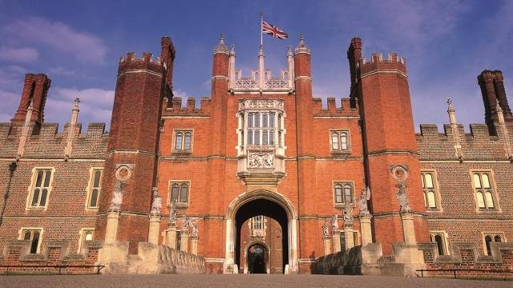
Other Possible Reasons
A male heir was a political necessity to most Europeans in the 16th century; the last time the English throne was left to a woman (Matilda), England was torn apart by Civil War
Henry had fallen in love with one of the ladies of the court and wanted to marry her
Anne Boleyn didn’t want to be “just” the king’s mistress, but his spouse

Slide 6
Omens of Henry’s Sin
No male heir
Mistress, Elizabeth Blount, had birthed a healthy son in 1519
In 1524 Henry was almost killed in joust with Duke of Suffolk
In 1525 Henry was thrown from horse into a ditch and his face stuck in the mud
Charles V broke his engagement to the Princess Mary
In July 1525 the plague struck the country, returning periodically for next two years
In winter 1527 sea froze over

Slide 7
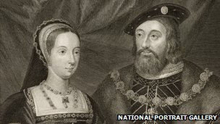
Precedents for Annulment
Henry’s sister Margaret, widow of James IV, had been “divorced” from her second husband, Earl of Angus
Henry’s brother-in-law (Charles Brandon, Duke of Suffolk) had his marital history fixed in order to marry king’s sister Mary
Louis XII of France had his first marriage dissolved so he could marry his father’s widow

Slide 8
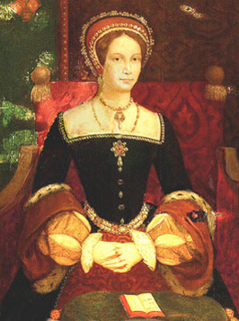
Arguments against Annulment
Henry’s marriage to Catherine of Aragon (widow of Prince Arthur) was legitimized by a papal dispensation of 1503
Henry wasn’t “childless” (unless one didn’t count female children)
Catherine swore marriage to Arthur had never been consummated: she came to Henry “a true maid without touch of man.”

Slide 9
Other Possible “Solutions”
Catherine could have gone voluntarily to a nunnery, leaving Henry free to marry again
Princess Mary could be married to her first cousin James V of Scotland and their offspring declared heir to English throne
His Holiness was willing to sanction bigamy, legitimize any children of Henry and his mistress, bless marriage of Henry’s bastard son, Duke of Richmond, with Princess Mary
Never suggested, but certainly Machiavellian: Catherine could have been quietly “done in.”

Slide 10
Dating the King’s Conscience
First documented evidence of an annulment justified on grounds of conscience in May 1527
Many historians believe Henry thought of ending the marriage as early as 1518, the year of the queen’s last pregnancy
Edward Stafford, Duke of Buckingham, at his treason trial in 1520 stated God was punishing Henry for his tainted marriage
Catherine reached menopause some time in 1524

Slide 11
Wolsey’s Attempt to Solve “Problem”
In May 1527 in his role as papal legate Wolsey summoned Henry to appear before him and his canon lawyers to answer the charge that he was living in sin with his late brother’s widow
Wolsey asked Henry to produce the papal bull of dispensation and he discovered several “canonical weaknesses in the bull”
But this maneuver depended on Catherine not knowing of the hearing because she had right to appeal any decision to Rome (and of course she found out and appealed)
Even the clerics couldn’t agree on proper interpretation of canon law since Deuteronomy 25:5 commanded men to take their brother’s childless widow and breed children

Slide 12
Political Complications
Situation in Rome was not favorable to Henry’s cause
The Pope, Clement VII, had been taken prisoner by the imperial troops of Charles V (Catherine of Aragon’s nephew)
Pope Clement only acted in 1528 when French troops drove Charles’ troops out of Rome – he agreed to authorize a hearing of the case in London.
Two cardinals – Wolsey and Campeggio, were to hear the arguments for and against the marriage and rule on its soundness on behalf of the Pope
Legatine Court convened on June 18, 1529 but Cardinal Campeggio had been given secret instructions to “decide nothing, for the Emperor is victorious and we cannot afford to provoke him”
Pressure from Charles V forced Clement to move the case to Rome
Wolsey fell from power as a result

Slide 13
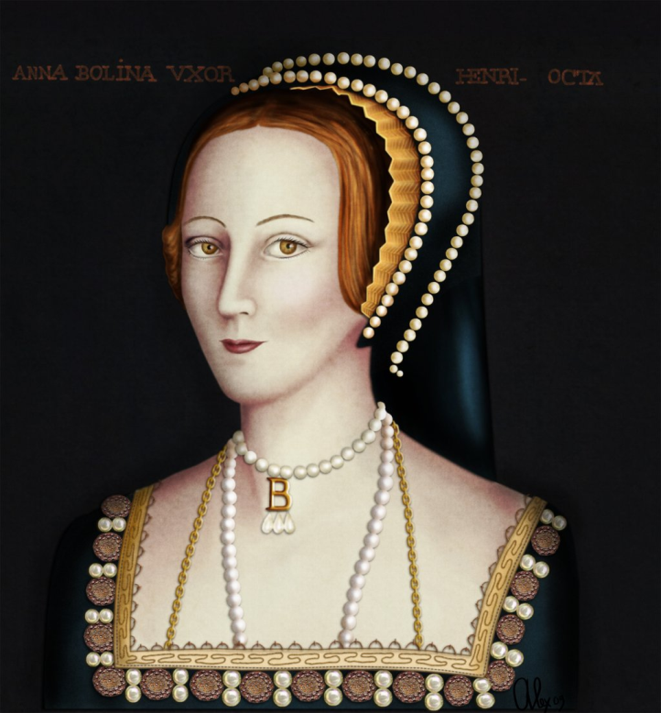
Need for Urgency
Anne finally gave in to Henry’s desires and in December 1532 she became pregnant
Elizabeth I’s chronicler later gave the marriage date as November 1532 but most historians believed the couple were married secretly in January 1533.

Slide 14
An English Church
Early in 1533 Archbishop William Warham was replaced as Archbishop of Canterbury by Thomas Cranmer, a man with Lutheran sympathies
In April 1533 parliament ruled that all spiritual cases “shall be from henceforth…definitely adjudged and determined within the King’s jurisdiction and authority [and] not elsewhere.”
In May 1533 an ecclesiastical court ruled Henry’s marriage to Catherine (now Dowager Princess of Wales) was null and void.
On June 1, 1533 Anne Boleyn was crowned Queen

Slide 15
An English Church (cont’d)
Pope Clement responded by excommunicating Henry (secretly)
On September 7, 1533 Queen Anne was delivered of a healthy baby – Elizabeth
In November 1534 parliament passed an Act of Supremacy that made the king the “Supreme Head of the Church of England”
Statute of Six Articles in 1539 clarified the doctrine of the English CATHOLIC Church

Slide 16
Statute of Six Articles An Act Abolishing Diversity in Opinions
First, that in the most blessed Sacrament of the Altar, by the strength and efficacy of Christ’s mighty word, it being spoken by the priest, is present really, under the form of bread and wine, the natural body and blood of Our Saviour Jesus Christ, conceived of the Virgin Mary, and that after the consecration there remaineth no substance of bread and wine, nor any other substance but the substance of Christ, God and man;
Secondly, that communion in both kinds is not necessary ad salutem, by the law of God, to all persons; and that it is to be believed, and not doubted of, but that in the flesh, under the form of the bread, is the very blood; and with the blood, under the form of the wine, is the very flesh; as well apart, as though they were both together.
Thirdly, that priests after the order of priesthood received, as afore, may not marry, by the law of God.

Slide 17
Statute of Six Articles (cont’d) An Act Abolishing Diversity in Opinions
Fourthly, that vows of chastity or widowhood, by man or woman made to God advisedly, ought to be observed by the law of God; and that it exempts them from other liberties of Christian people, which without that they might enjoy.
Fifthly, that it is meet and necessary that private masses be continued and admitted in this the King’s English Church and Congregation, as whereby good Christian people, ordering themselves accordingly, do receive both godly and goodly consolations and benefits; and it is agreeable also to God’s law.
Sixthly, that auricular confession is expedient and necessary to be retained and continued, used and frequented in the Church of God:. . . It is therefore ordained and enacted.. . .

