Slide 1
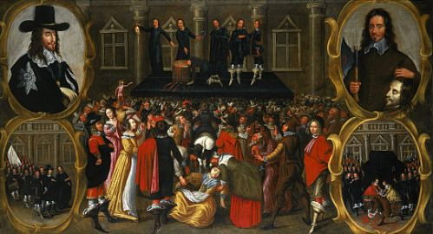
Civil war, restoration, and glorious revolution

Slide 2
Origins of the civil war
Edward Hyde, later Lord Clarendon, a parliamentarian turned royalist, believed the English Civil War was the last “great rebellion”; historian C.V. Wedgwood, an internal war caused by a temporary political breakdown. The Whig historian Thomas Macaulay argued that Parliament was defending traditional English institutions against a foreign king who wished to establish an absolute monarchy and deprive English subjects of their historic rights. S.R. Gardiner, a church historian and a Whig, described the Civil War was a “Puritan Revolution.” Marxist Frederick Engels saw the event as the first bourgeois revolution or, as historian Roger Tawney later explained, the consequence of the “rise of the gentry” and the decline of the aristocracy. H.R. Trevor-Roper saw a revolution of despair, engineered by the mere gentry.

Slide 3
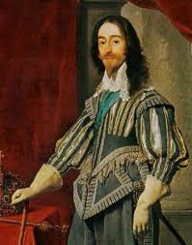
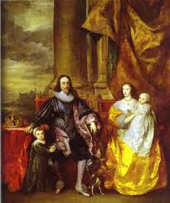
Most historians see the lack of trust between Charles I and Parliament as the main factor that led to conflict in 1642. Charles believed that Parliament wanted to overthrow the monarchy and create a republic. Parliament feared to put an
army into the hands of the
king, convinced he would
use it against the Commons.

Slide 4
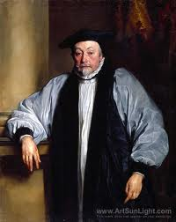
Charles’ personality and the policies of his government (particularly those of Archbishop Laud and the Earl of Stratford) in the years from 1629 to 1639 brought
the crisis to a head. Things
fell apart first in Scotland
when Laud decided to impose
the English system of worship
on the Scottish church. The
Scots rebelled and organized an army to march on England resulting in what was known as the Bishops’ War.

Slide 5
The constitutional crisis was provoked as much by Parliament as by the crown. Between June 1641 and the outbreak of Civil War in August 1642, radical MPs made sweeping statements of parliamentary rights that clearly implied parliamentary sovereignty; e.g., the Grand Remonstrance of December 1641 and the Nineteen Propositions of June 1642. Charles, in rejecting the propositions, argued that the English constitution supported a mixed government and accused Parliament of dangerous constitutional innovations.
The issue after 1640 was no longer that of the abuse of the royal prerogative. Parliament and the king were engaged in a battle over sovereignty.

Slide 6
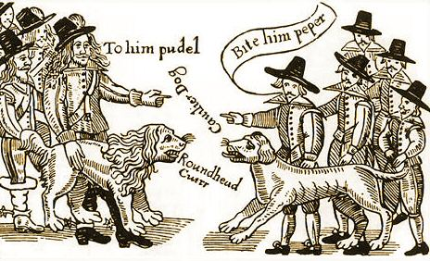
Civil War broke out in 1642 between supporters of the King (Royalists) and supporters of parliament (Roundheads).
June 1645 Cromwell’s Model Army decisively defeated King’s forces at Nasby. Charles surrendered to Scots who sold him to parliament. Charles escaped from his confinement in November 1647 and a short, 2nd Civil War broke out in 1648.

Slide 7
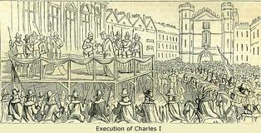
Charles was tried at for treason at Westminster Hall in January 1649, and found guilty that he had “traitorously and maliciously levied war against the present Parliament and the people therein represented.”
Charles was executed
on January 30th, 1649.
outside the Banqueting Hall. The monarchy and the established church were abolished and a Republic declared. In reality, England was in the hands of Oliver Cromwell and his major generals.

Slide 8
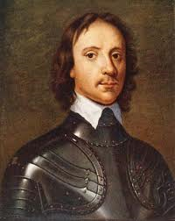
The period between Charles I’s execution in 1649 and Charles II’s return to the throne in 1660 is called the Interregnum.
Propertied classes baulked at
new taxes
military rule
religious and social upheaval
With death of Cromwell in 1658, major generals worked for the return of the monarchy and a government of King, Lords, and Commons.

Slide 9
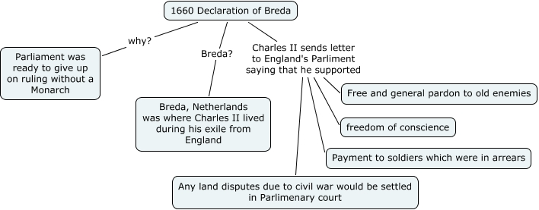
The restoration
Long Parliament (1640 – 1660) dissolved itself
Elections held for Convention Parliament
Charles issued his Declaration of Breda in April 1660 outlining his conditions for return
Charles was invited “to take the government of the kingdom upon his shoulders” and arrived in England in May 1660.

Slide 10
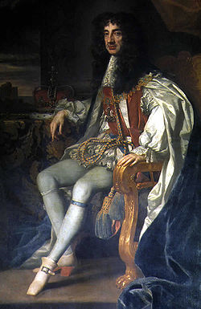
Charles II (1660 – 1685)
Determined not to go on his
“travels” again
Known as the “merrie
monarch”
Favored toleration but
agreed to Test Act and other
restrictions on Catholics and Dissenters
Signed Treaty of Dover in 1670 (secretly) with Louis XIV of France

Slide 11
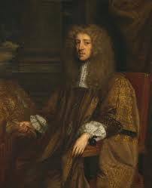
Exclusion Crisis of 1678-81
Set off by "Popish Plot" (Jesuits would kill Charles II and place James on throne)
Led to legislation to exclude James from throne introduced by Anthony Ashley Cooper,
Earl of Shaftesbury, and supporters,
known as Whigs Charles dissolved parliament moved parliament to royalist Oxford
Opposed by Sir Thomas Osborne, Earl of Danby, and Tories -court party based on union of crown and church
Failed in efforts to exclude James 1)disagreed on successor (Mary/Duke of Monmouth?) 2)feared civil war -Shaftesbury arrested for treason & fled to Holland -Charles reorganized local government: Whigs replaced by Tories -clergy preached sinfulness of resistance

Slide 12
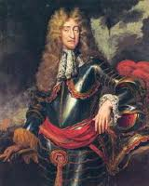
James II’s Reign (1685 – 1688)
-Succeeded peacefully in February 1685 but believed
Catholic king never safe
-Confirmed by June 1685 peasant rebellion led by
Duke of Monmouth
quickly routed & dealt with harshly (“Bloody Assizes”)
300 condemned to death; 800 sold into slavery in the West Indies
-Used rebellion as excuse
to increase size of army
to appoint RCs to positions in military and government
to move the Anglican Church closer to the Roman Catholic
-Sent envoys to Mary and Anne asking them to convert
-Turned to the Whigs (thought ties with Dissenters made receptive to toleration)
April 1687 Declaration of Indulgence gave Disssenters and Catholics
full religious freedom
Archbishop of Canterbury, William Sancroft, and six other bishops
imprisoned when protested its illegality

Slide 13
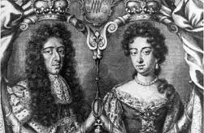
“Protestantism and Liberty”
On 10 June 1688 son born to James and Mary baptized into RC faith
Seven prominent Englishmen sent invitation to William, Prince of Orange, and wife Mary to come to England to defend "Protestantism and Liberty" fearful of Catholic dynasty James Edward was “warming pan” baby
In November 1688 William and Mary landed in England ships powered by “Protestant Wind” James fled London and took refuge in France William and Mary asked to take over
Convention Parliament called for February 1689

Slide 14
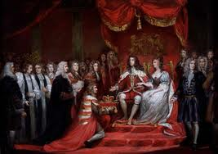
Convention Parliament
Declared that James had abdicated and throne was vacant
Offered joint crown to William and Mary
Put parliamentary limitations on sovereignty with Declaration of Rights
Resulted in the establishment of a limited or constitutional monarchy

Slide 15
Declaration of Rights (later Bill of Rights)
-guaranteed freedom of speech, freedom of elections, parliamentary approval of taxation, and the right to petition
-forbade cruel and unusual punishment, standing armies, suspension of the law, and due process
-stated that no Catholic could succeed to throne of England
Claim of Right
-Scottish Estates approved a similar document in April 1689
-stated that no Catholic could succeed to throne of Scotland
-established Presbyterianism as the Church of Scotland and maintained Scottish legal system

Slide 16
Other Consequences of Glorious Revolution
Mutiny Act in 1689 limited royal use of martial law to one year
Toleration Act of 1689 gave freedom of worship to Dissenters but kept Test and Corporation Acts and the penal laws against Catholics
England involved in Nine Years’ War (1688-97) instigated by Louis XIV's provision of men, money, and ships to James II
James sailed to Ireland to recover the throne of England;
defeated by William 1690 Battle of the Boyne;
legislation reduced RCs in Ireland to virtual slavery:
could not hold office, sit in parliament, vote in elections,
serve on jury, practice law, teach school, purchase land,
or own horse worth more than £5
N.B. Scots fared better: Presbyterianism recognized as Church of Scotland
Annual parliaments and new sources of revenue needed
1693 permanent national debt
1694 Bank of England
Victories in the War of Spanish Succession (1702-13) established
England as major force in continental politics

Slide 17
Act of Settlement of 1701
-caused by Mary's death in 1694, William’s failure to remarry, and Anne's loss of only surviving child, Duke of Gloucester in 1700
-succession would pass to Anne upon William’s death and then to Princess Sophia of Hanover and heirs
-ruler must be practicing Anglican
-could not leave England without the consent of parliament
-England not automatically obliged to defend ruler's foreign territories
-office holding closed to foreigners
-all ministerial decisions made in Privy Council and properly minuted
Social Contract Theory of Government
-Bill of Rights, Toleration Act, Mutiny Act, Triennial Act, and Act of Settlement political embodiments of John Locke's social contract theory of government
-government was agreement between ruled and ruler for the purpose of protecting life, liberty, and property
-premise of Treatise on Government radical: Revolution ultimate safeguard of the law

