Slide 1
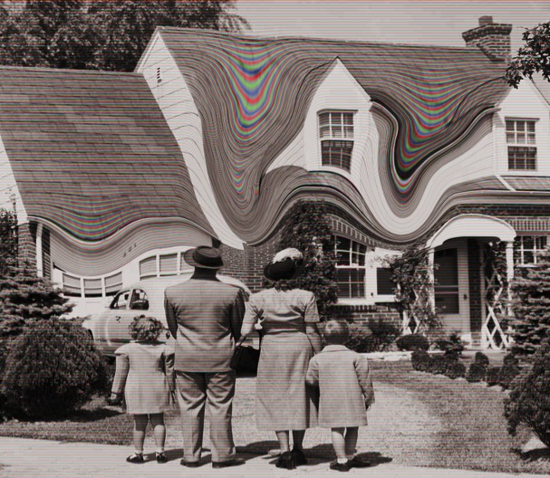
White Noise
by Kristen Barbour

Slide 2
Critical Argument
What does the “white noise” of the title refer to?
Does Don DeLillo portray it as a comfort or concern of modern society?

Slide 3
Diane Johnson
“White Noise is a meditation on themes of whiteness—the pallor of death, and white noise, the sound, so emblematic of modern life, that is meant to soothe human beings by screening out the other, more irritating noises of their civilization.”
Evidence:
pg. 78 – Gladney finds Wilder’s inconsolable crying “strangely soothing” and momentarily loses himself in it.
Notes:
White Noise is a meditation on themes of whiteness—the pallor of death, and white noise, the sound, so emblematic of modern life, that is meant to soothe human beings by screening out the other, more irritating noises of their civilization.
http://www.nybooks.com/articles/archives/1985/mar/14/conspirators/
Conspirators by diane johnson

Slide 4
Karen Weekes
“…it is both the background noise that constantly bombards us and a way for us to avoid that bombardment…Thus the term “white noise” can be used in either a positive or a pejorative sense, depending on whether it refers to an unremitting noise one is trying to escape or to the sound introduced as escape
Evidence:
pg. 78 – Gladney finds Wilder’s inconsolable crying “strangely soothing” and momentarily loses himself in it.
Notes:
Weekes, Karen. "Consuming And Dying: Meaning And The Marketplace In Don Delillo's White Noise." L I T: Literature Interpretation Theory 4 (2007): 285. Academic OneFile. Web. 13 Sept. 2014.

Slide 5
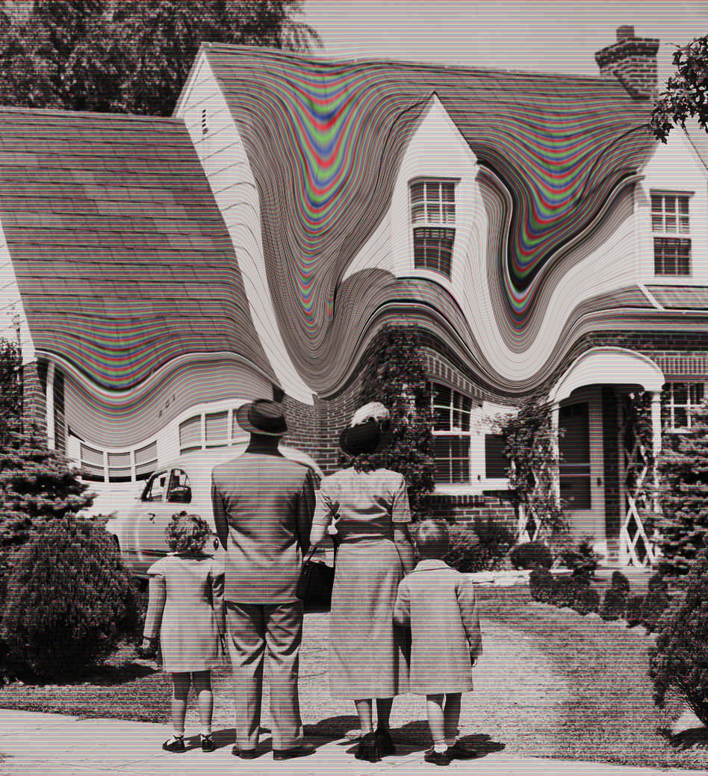
Tom LeClair
White noise is more than cultural detritus. It is “the manifestation of an attempt to communicate one's fear and hence to ‘bridge the lonely distances.’”
Evidence:
Concerning the text on pg. 198 – “Life, Jack says here, is lived in virtually unbroken terror that it will end. How do we survive? Babette urges them both on to the notion that death itself might just be filled with white noise. And if that is so, what is all the noise—not just media/consumer noise but the noise they make while they ‘walk around, talk to people, eat and drink’—that surrounds them in life? It can only be their intimations of death; it is the death-fear expressed in the only terms that a postmodern media culture knows how to express it.”
Notes:
Baudrillard, DeLillo's "White Noise," and the End of Heroic Narrative
Leonard Wilcox
Contemporary Literature, Vol. 32, No. 3 (Autumn, 1991), pp. 346-365
Published by: University of Wisconsin Press
Article DOI: 10.2307/1208561 pg.349
Article Stable URL: http://www.jstor.org/stable/1208561

Slide 6
Karen Weekes
“A second economic definition of ‘‘white noise’’ is equally applicable to this text: a random event that has the potential to cause a permanent alteration in behavior, but instead results in a temporary change.”
Evidence:
The Airborne Toxic Event in part II and how life returns to normal for the Gladney’s afterwards in part III
Notes:
Weekes, Karen. "Consuming And Dying: Meaning And The Marketplace In Don Delillo's White Noise." L I T: Literature Interpretation Theory 4 (2007): 285. Academic OneFile. Web. 13 Sept. 2014.

Slide 7
Leonard Wilcox
implies a neutral and reified mediaspeech, but also a surplus of data and an entropic blanket of information glut which flows from a media saturated society which threatens the concept of meaning itself
Evidence:
DeLillo originally wanted to title the novel ‘‘Panasonic’’ until prohibited by Matsushita Corporation. That name would indicate both the ubiquity of sound as well as its corporate associations, given the brand-recognition that the trademark name Panasonic enjoys.
Gladney sifts through the layers of white noise—electronic media, printed information, traffic sounds, computer read-outs—listening for significance, for a grasp of essence in the flux. In modernist fashion, he struggles in an almost Sisyphean way to glean meaning from the surrounding noise of culture…
Notes:
Baudrillard, DeLillo's "White Noise," and the End of Heroic Narrative
Leonard Wilcox
Contemporary Literature, Vol. 32, No. 3 (Autumn, 1991), pp. 346-365
Published by: University of Wisconsin Press
Article DOI: 10.2307/1208561 pg.349
Article Stable URL: http://www.jstor.org/stable/1208561

Slide 8
David Brauner
“…white noise seems to symbolize both death and life, or perhaps the mysterious construct connecting the two, the soul: that which is felt instinctively to exist but remains forever unlocatable, ‘just outside the range of human apprehension’, but at the same time tantalizingly ‘approaching the threshold of perception’.”
Notes:
Brauner, David, and Millard, Kenneth. Contemporary American Fiction. Edinburgh, GBR: Edinburgh University Press, 2010. ProQuest ebrary. Web. 13 September 2014. pg. 30-31

Slide 9
Evidence
Life:
pg. 15 – Babette “emits a creaturely hum”
pg. 36 – describes the sound of the supermarket as “a dull and unlocatable roar, as if some form of swarming life just outside the range of human apprehension
pg. 258 – the refrigerator makes a sound that is “an eerie static, insistent but near subliminal, that made me think of wintering souls, some form of dormant life approaching the threshold of perception
Death:
pg. 4 – “the sparse traffic washes past, a remote and steady murmur around our sleep, as of dead souls babbling at the edge of a dream
pg. 198:
“What if death is nothing but sound?”
“Electrical noise.”
“You hear it forever. Sound all around. How awful.”
“Uniform, white.”

Slide 10
Edgar Landgraf
White noise is the “multiplicity of incongruent realities,”—that is, individual realities (perceptual, emotional, physiological) are bound to clash with the imposing, impersonal realities created by science, medicine, advertising, and the mass media
“the result of multiple, incongruent systems realities ‘sounding’ together, robs the information processing of the media of its content, turning information—and the indistinctness of the distinction between information and non-information—into noise. With regard to the simultaneous assertion ‘of all frequencies,’ everything is nothing: the totality of distinctions turn into an indistinct mash.”
Evidence:
pg. 22 – 24 Heinrich and Jack argue over whether it is actually raining according to the physical sensation and what the radio has forecasted.
Notes:
Schinko, Carsten, and Hannes Bergthaller. Addressing Modernity : Social Systems Theory And U.S. Cultures. Amsterdam: Rodopi, 2011. eBook Collection (EBSCOhost). Web. 13 Sept. 2014.
Written by Edgar Landgraf, pages 85-112

