Slide 1
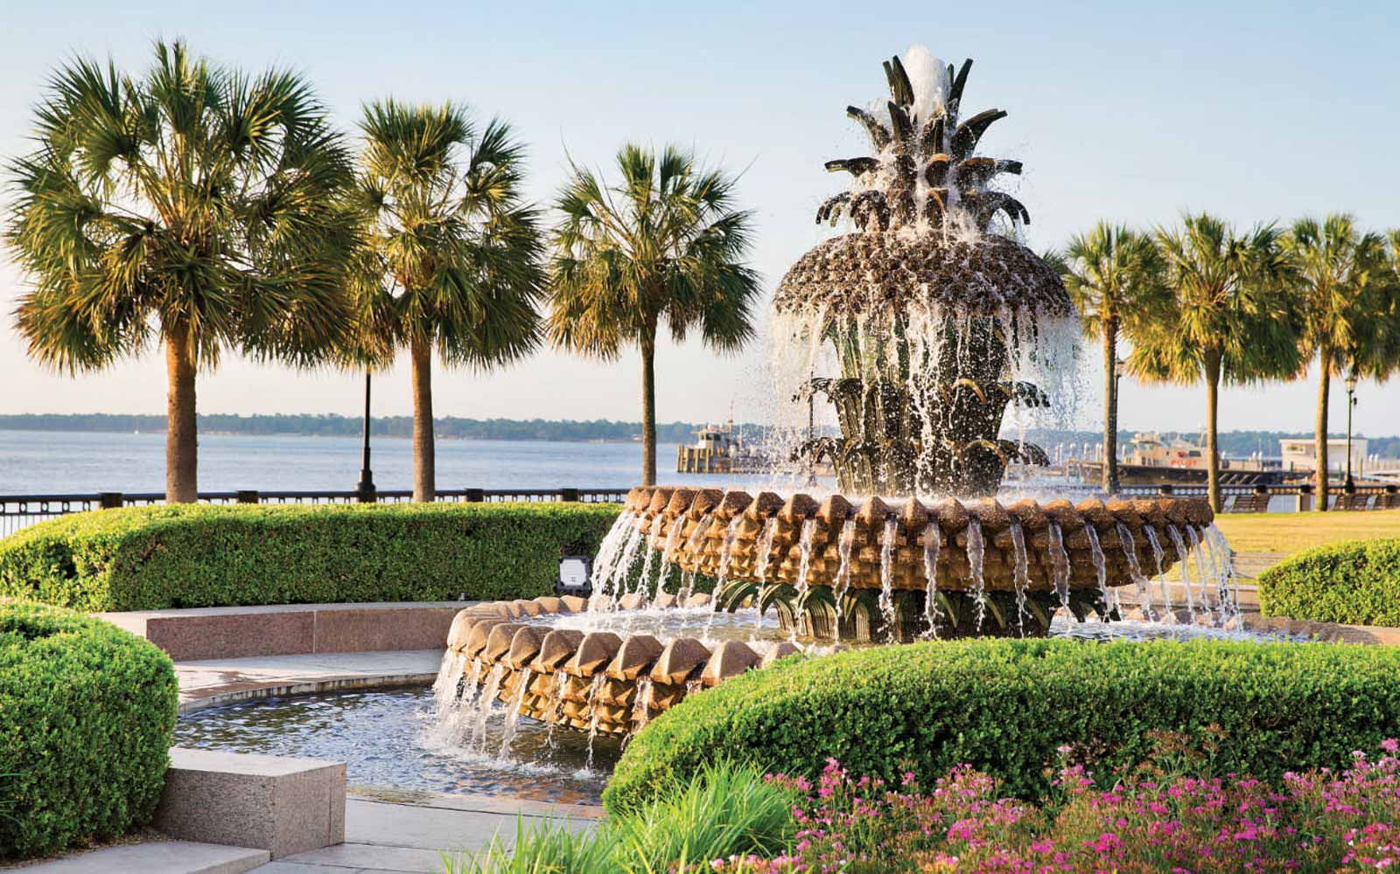
The Music of Charleston
A Brief Historical Survey
By Wojciech Milewski

Slide 2
When you think of “Charleston Music” today, what do you think of?

Slide 3
Survey Says!
The Charleston music scene today is vibrant, cosmopolitan, and diverse
It is centered around three main hubs:
Jazz
Traditional European-style Classical music
Folk Music

Slide 4
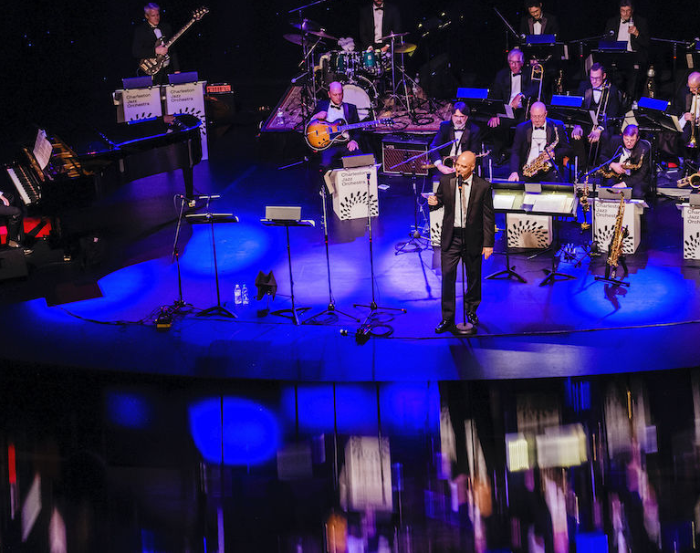
Jazz:
Charleston Jazz Orchestra - professional jazz big band
Charleston Jazz Initiative - research group
The Commodore & Forte Jazz Lounge - jazz performance spaces
Joe Clark Big Band - 2nd jazz big band in town
SOJazzy - small 6-8 piece jazz ensemble

Slide 5
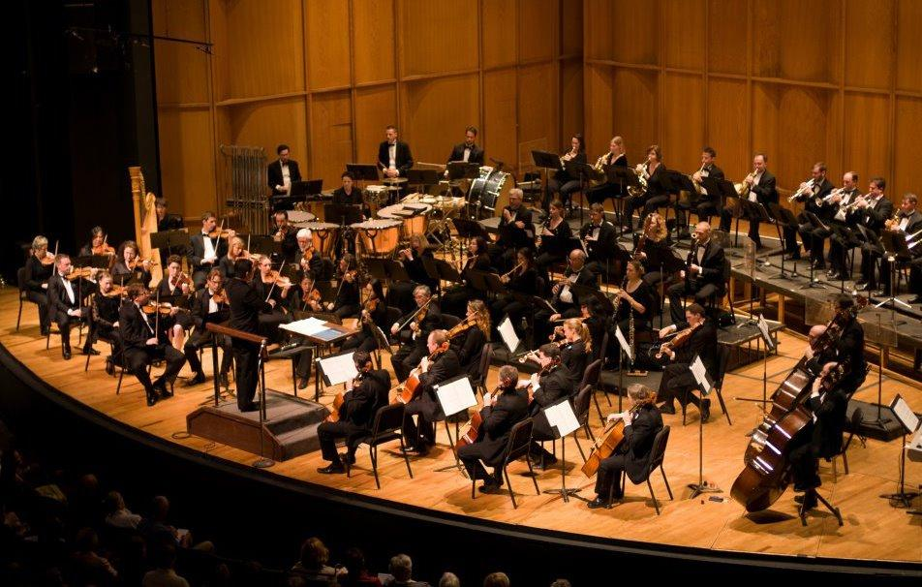
Classical:
Charleston Symphony
Charleston Youth Symphony
Charleston Symphony Chorus
Spoleto Festival
Piccolo Spoleto
Chamber Music Charleston
Taylor Festival Choir
2 new opera companies as of 2020
Charleston Opera Theater
HALO (Holy City Arts & Lyric Opera)
2 amateur orchestras:
Mt. Pleasant Symphony (formerly Southcoast)
Summerville Orchestra

Slide 6
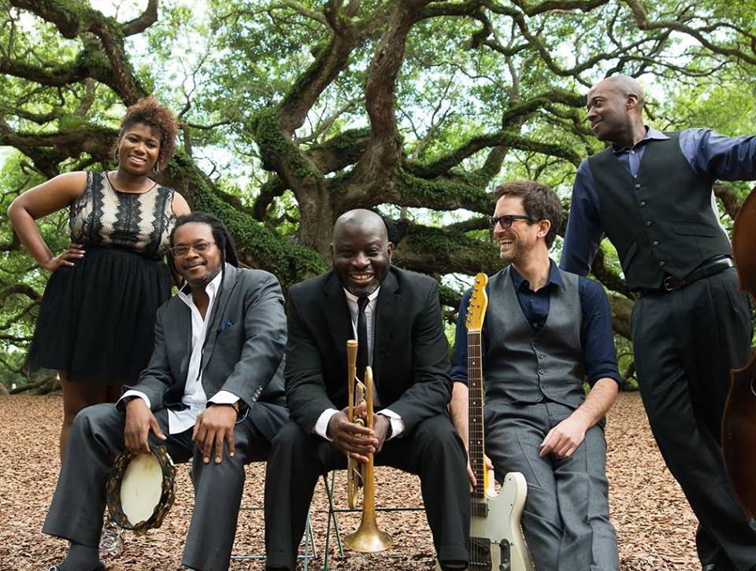
Folk:
Traditional Gullah/Geechee music & dances
Kum-Ba-Yah
”The Charleston”
Ranky Tanky – Charlton Singleton’s Grammy-award winning group
Hootie & the Blowfish – Darius Rucker, Charleston’s native son
High Water Festival – national caliber folk/bluegrass/country festival
Various venues around town

Slide 7
Was it always like this? How did we get here?

Slide 8
Pre-Revolution
Charleston was the “crown jewel” of the British colonies
Most important port city in the colonies at the time
Largest Atlantic Ocean hub of commerce, and of the African slave trade
Estimated that 40% of all Africans imported to the US came through Charleston
Charleston was the chief point of attraction for professional musicians emigrating from Europe
Notes:
8 -> 9 – WHY?

Slide 9
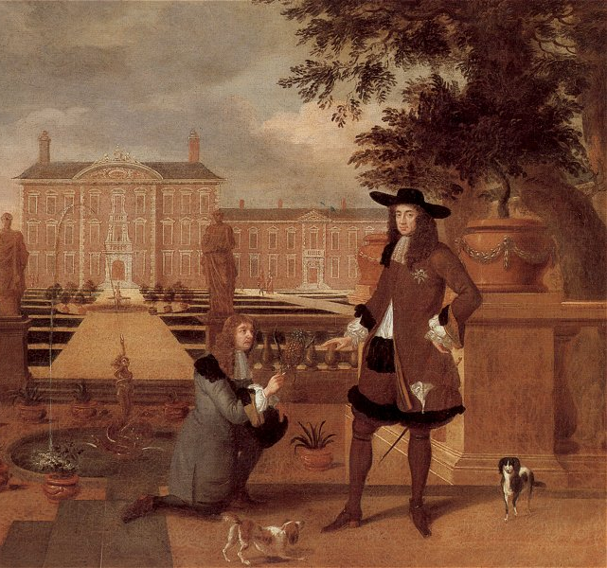
“Charleston approached more nearly the social refinement of a great European capital than any other American city”
- Edmund Burke
Notes:
Music was the essential ingredient of social refinement; 9-10 -> As a result, Charleston grew rapidly!

Slide 10
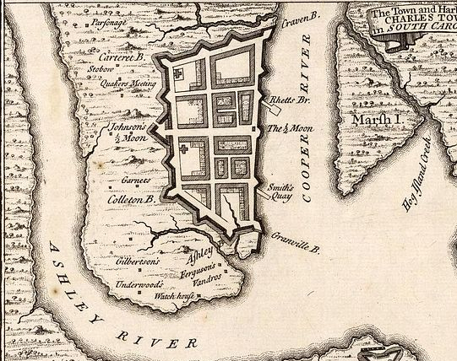
A City of Firsts
1735 – First opera produced in the ”United States”
“Flora” – a successful British ballad opera
Performed & premiered in a makeshift theater in Sheapeard’s Tavern (now Citizen’s Bank)
In 1736, performed at the brand-new Dock Street Theater
Many successful operas followed from Europe, and were performed regularly in Charleston, including The Beggar’s Opera (John Gay), Love in a Village, and the Poor Soldier.
1762 – First (and oldest) "musical society” created founded in Charleston
St. Cecilia Society
Additional ones soon sprang up: i.e. Sons of St. Patrick

Slide 11
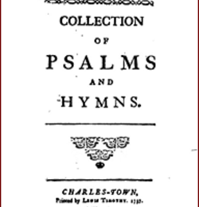
And another “first”
1737 – John Wesley’s “A Collection of Psalms & Hymns”
Published in Charleston
For the (then) rather radical practice of “hymnody”
It was the first of his translations of German hymns taken from Moravian missionaries
This volume presents a tangible link between Methodist hymnody and American colonies
Notes:
Significant: church music & religious music grew to be a huge factor in Charleston/South

Slide 12
Two important quotes about the time:
“The general pattern of 18th - century American urban culture was the imitation of European standards of taste”
- Gilbert Chase
“In the liberal 18th – century attitude there was room for all: famous masters and local lights, professionals & amateurs, immigrants & native-born. The important thing was to have music, a lot of it, and the best that could be had. ”
- Gilbert Chase

Slide 13
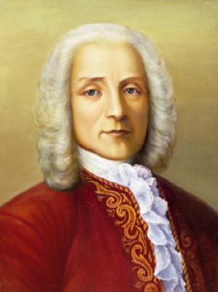
(Famous) Professionals & Amateurs
1737 – Theodore Pachelbel’s Concert in Charleston
Son of Johann Pachelbel (“Canon in D”)
For the “Benefit of Mr. Theodore Pachelbel”
Emigrated to Rhode Island, then gave concerts in NY in 1736 before coming to Charleston one year later
1760 – A “Concert of Vocal & Instrumental Music”
To be given with “the assistance of Gentlemen who are the best performers, both in Town and Country.”
Refers to “gentlemen amateurs” who played music because they loved it.
Not enough professionals to make up an entire ensemble

Slide 14
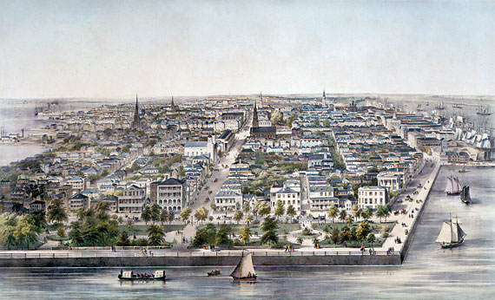
Rapid growth
Charleston grew rapidly, and commerce boomed
4th largest colonial city in 10 years of growth (1680-1690)
Wealthiest city in the colonies by 1775
Plantations, port trade, and other commerce
Largest population south of Philadelphia (11,000 inhabitants in 1770)
Soon, the “3 conditions for art” were in abundance:
Population
Wealth
Leisure

Slide 15
“When these three factors assume a large proportion in any society, the consumption of art tends to increase, and may indeed become itself a major economic enterprise”
- Gilbert Chase

Slide 16
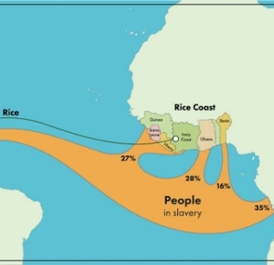
Slavery in Charleston
To fill labor needs, especially on plantations – rice, sugar, cotton, etc.
Prior to the African slave trade, the “Indian slave trade” was massive
And, as noted before, 40% of Africans imported into North America came through Charleston (1700-1775);
up to 50% total by the end of the slave trade
From various parts of the African continent, predominantly the West Coast (“Rice Coast”)
1775 – over half of the population of Charleston was enslaved
Notes:
Rice – why important? The influence of culture/music

Slide 17
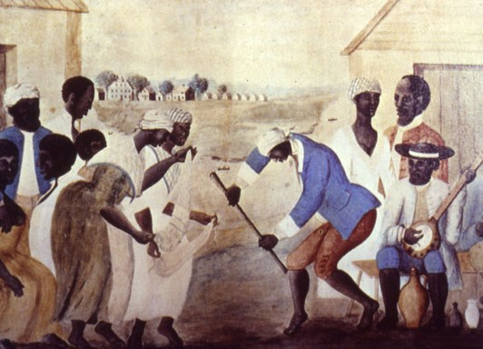
Led to creation of:
Gullah-Geechee culture:
According to British historian P.E.H. Hair, Gullah culture developed as a creole culture in the colonies and United States from the peoples of many African cultures who came together there
Rice plantations had hundreds of laborers
African traditions reinforced by imports from the same regions.
Community life, traditions, languages, cultures all developed and were preserved
These included work/field songs, ceremonial, celebratory and “day music”, and much more
Notes:
Work/field songs – more research done now attributing Islamic roots to these practices; similar traditions and ideas (i.e. praising God)

Slide 18
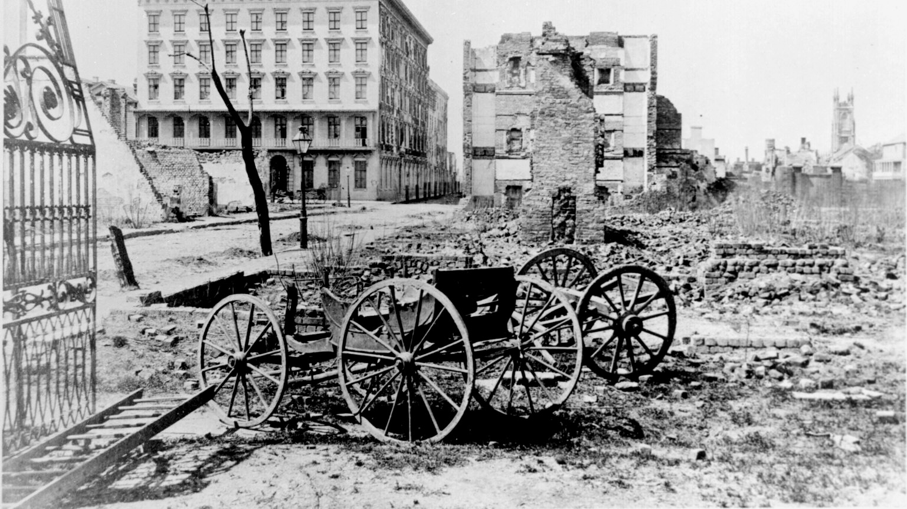
Post-Revolution
Musicians (and populations) began to drift north to New York, Philadelphia and Boston
The Northern United States soon became a more important place of growth and development
The South, especially Charleston & S.C., remained an agricultural force

Slide 19
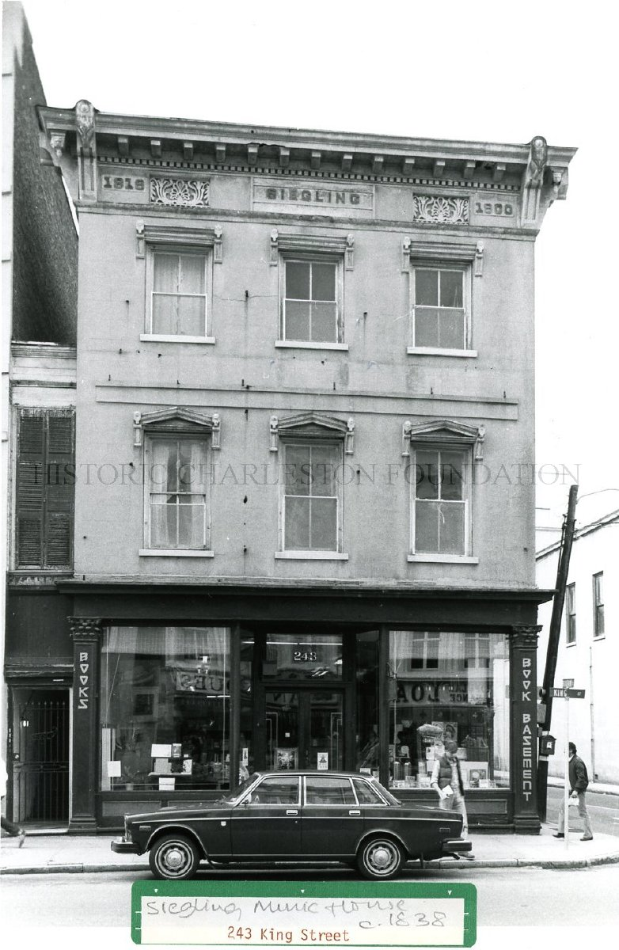
Post-Revolution Boom
By 1819 – European-style Classical music thrived
1819 - First 30-person orchestra formed in Charleston
Performed intimate concerts for family & friends
Comprised of professionals and amateurs
1819 – Seigling Music House established
On King St., founded as a retail music store
Demand for classical sheet music at an all-time high
Also a publishing house for local composers

Slide 20
Civil War & Education
1860 – South Carolina secedes from the Union, Charleston besieged after attack on Fort Sumter
1865 – Northern/Union victory
Plantations destroyed by occupying Northern troops,
Economy of the city and state was in ruins,
Slaves freed
1884 – Charleston Conservatory founded
1891 – Jenkins Orphanage established

Slide 21
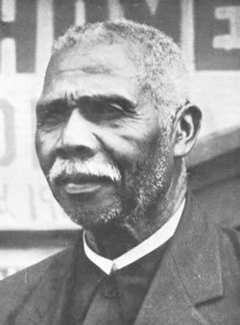
Daniel Jenkins & his Orphanage
In 1891 - Mass of peasant black labor with few land rights and no opportunity of emigration out of S.C. causes further despair and poverty in the Black population
1892 – Daniel Jenkins incorporates the Orphan Aid Society
Successful businessman and ex-slave Daniel Jenkins commits himself to a life of social work
Only Black orphanage in South Carolina
By late 1892, Jenkins had over 100 orphans under his care
Inspired by Booker T. Washington’s ”Tuskegee Singers,” Jenkins began to teach his kids music to help raise funds and teach tangible skills

Slide 22
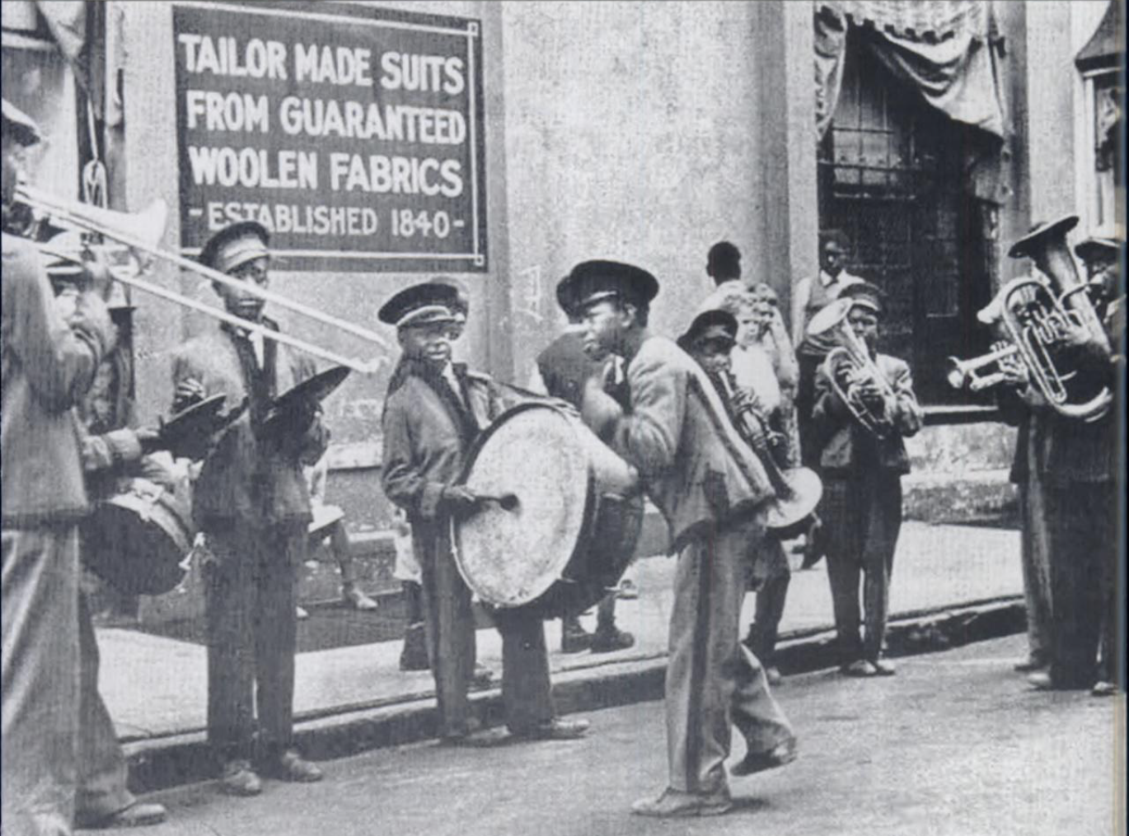
The Jenkins Orphanage Band
Jenkins obtained old, battered instruments as donations from Charleston residents
And discarded uniforms from the Citadel
The kids were taught by two local musicians and learned rapidly
By late 1893, they were sent North to play on street corners
During the time they were not in school, the “band” would make tours of the United States, subsequently bringing in funds for the Orphanage
One of these performances was even captured on film
Notes:
Practiced hours a day; when they weren’t in school, they were learning trades or practicing music ; they were a brass band (military band)

Slide 23
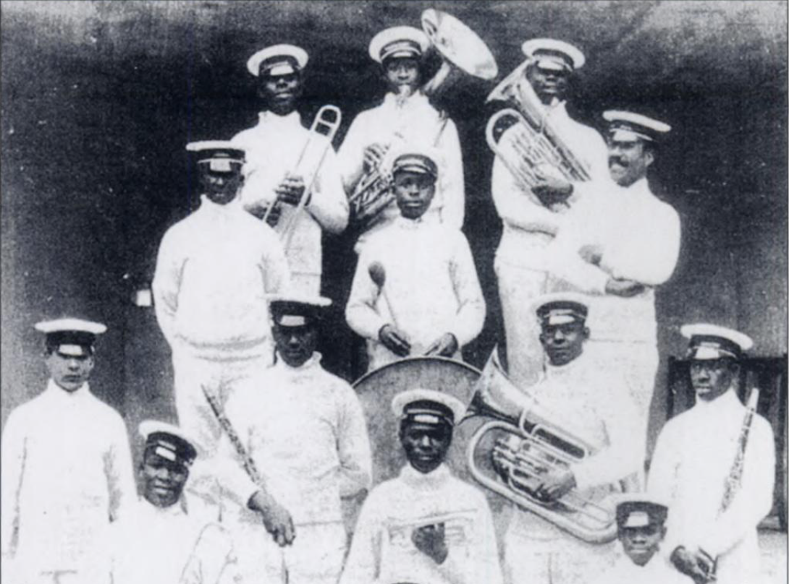
Jenkins Orphanage Band grows
Orphanage numbers grow:
End of 1893 – 360 children at the Orphanage
By June 1894 – nearly 500 children
Pastor Jenkins creates more ensembles to increase their touring
Bands sent up and down the East Coast each summer
These tours gave the Orphanage funding, notoriety, and contacts
In 1895, the band crossed the Atlantic to gather support and funds in England
1905 – Invited to play for President Roosevelt’s inauguration
1909 – for President Taft’s
1904 – Had their own stage at St. Louis’ “World’s Fair”
1914 – Invited to London to play at the Anglo-American Exposition
Notes:
“Therefore when they heard the unmistakeable nostalgic strains coming round the London corner, they definitely perked up their ears – Jane Wells’ (Smythe’s granddaughter); At the time – “ragtime” and “cakewalk” were beginning to take shape, plantation/field songs were now known, and the elements of march/military music began to fuse together

Slide 24
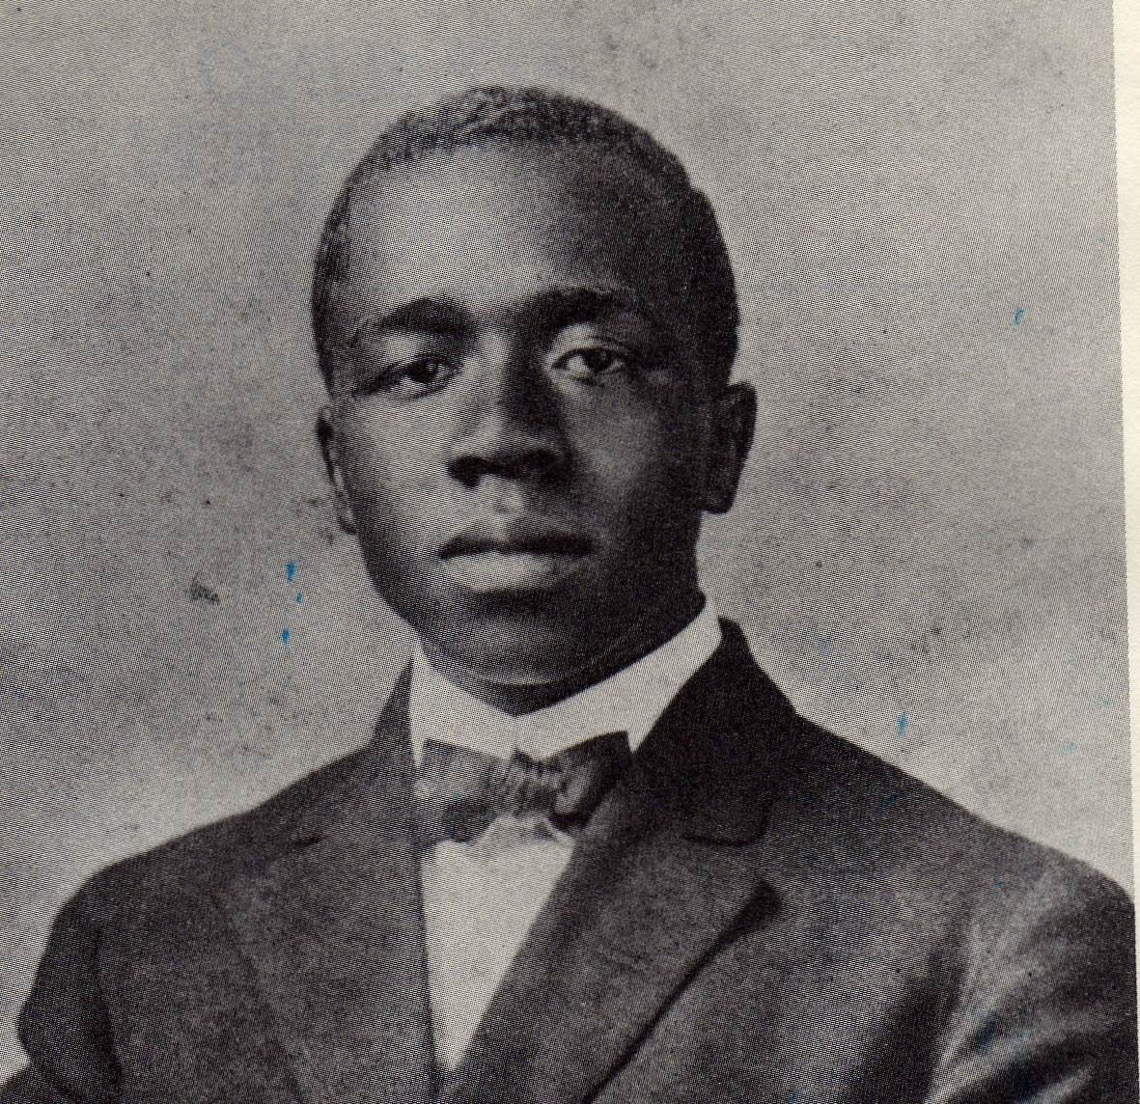
Edmund Thornton Jenkins
1894 – Edmund Thornton Jenkins born in Charleston, SC
Daniel’s 7th son, and one of 11 total children
Skilled musician who excelled at many instruments: clarinet, piano and violin
Major influences: The Metropolitan Opera, Samuel Coleridge-Taylor, Antonin Dvorak, Will Marion Cook, Jim Europe, and more
1908 – Attended Morehouse College in Atlanta, GA
Studied there for 6 years
Mastered three instruments, and in the summers led tours of the Jenkins Orphanage Band
1914 – Travelled with the Band to London for the Exposition
Enrolled in the Royal Academy of Music in September of that year
Studied composition and clarinet

Slide 25
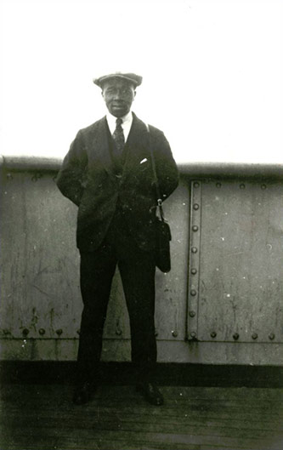
Edmund Thornton Jenkins
1916 – Showing promise & growth
By June of that year, Edmund had won an orchestral scholarship, and composed an overture that was well-received by all
“…the Overture indicated an engaging knowledge of orchestral effect which should carry the student far.”
1919 – Arranged for Will Marion Cook’s “Southern Syncopated Orchestra” to arrive in July, bringing new dance and jazz to Britain.
Offered the leadership position of the SSO during this time, but turned it down
December 7, 1919 – “Folk Rhapsody”
Jenkins’ “Folk Rhapsody” premieres on a concert of works by Samuel Coleridge-Taylor, conducted by Jenkins
Expanded and re-orchestrated in 1925 as “Charlestonia: A Folk Rhapsody”

Slide 26
Does anything in that piece sound familiar to you?

Slide 27
Charleston or Charlestonia?
The title of Jenkins’ rhapsody changed over the years (1919-1925):
Folk Rhapsody #1 (1919)
Charlestonia: A Folk Rhapsody (1923)
Charlestonia: Popular Negro Rhapsody (1923)
Charlestonia
Why? To avoid confusion with a dance that was taking over the nation:
James P. Johnson’s “The Charleston”
An early version

Slide 28
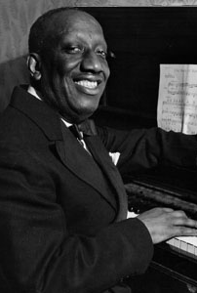
James P. Johnson’s “Charleston”
First appeared in the 1923 Broadway musical “Runnin’ Wild”
Inspired by:
Charleston native Eubie Blake’s 1921 “Charleston Rag” from the Broadway musical Shuffle Along
1st Broadway show written and directed by African-Americans
Observing Charlestonians and the Jenkins Orphanage Band musicians in Charleston dancing/playing Geechee movements
Music was an evolution of marches, ragtime, and traditional Gullah/Geechee music
The dancing was a traditional part of this music and similar steps have been seen in Haiti, Cape Verde, and the Ashanti tribe
Homage to Charleston’s role in the development of jazz
Notes:
The JOB connection is a recent one; credit given to Gullah community

Slide 29
Fusion of Styles
“It may boil down to the simple notion that we have known more about New Orleans’ jazz origination and that those beginnings have been trumpeted more loudly than any other of the many birthplaces of American improvisational music. Charleston is one of those cradles – a very important one.”
Jack McCray, “Charleston Jazz”
“At the turn of the 20th Century, classical music was melding with indigenous influences, initiating the shift to a distinctly American style of music and the emergence of native composers, such as George Gershwin”
S.C. Encyclopedia

Slide 30
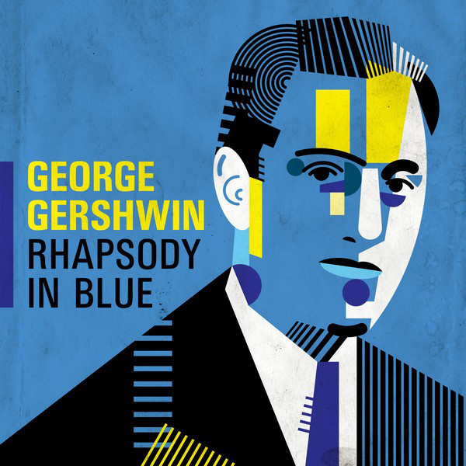
Gershwin & Charleston
“Composer George Gershwin’s contribution to the American scene is significant beyond his music itself in that he was able to reconcile the two points of view and achieve popular music in the large traditional forms.” – Gilbert Chase
1924 – Rhapsody in Blue
Opening clarinet glissando – Charleston jazz, Gullah, Jenkins Orphanage roots
Clarinetist Ross Gorman was a virtuoso jazz/ragtime player with a sense of humor.
1926 – Concerto in F for piano & orchestra
First movement features “Charleston” rhythms
Gershwin heavily inspired by James P. Johnson and his music

Slide 31
Porgy & Bess (folk opera) - 1935
1925 - DuBose Heyward writes a novel about a crippled street beggar from Charleston, S.C.
Heyward features Gullah language and culture as a main element of the story
Developed into a play of the same name in 1927
The Jenkins Orphanage Band featured prominently in the novel, and played for the entire duration of the Broadway run of Porgy
Gershwin reads the novel in 1926, and sees the play in 1929
Proposes an operatic collaboration to Heyward in 1933
1934 – Gershwin and Heyward visit South Carolina
Stays on Folly Beach, attends Gullah services and lives in their culture, and takes note of native Charleston street music and the cries of the vendors with their unique melodic inflections
Notes:
Heyward & JOB in attendance for re-opening of the Dock St. Theater in 1936, where the Charleston Symphony played for “The Recruiting Officer” at the premiere in their 1st season of existence

Slide 32
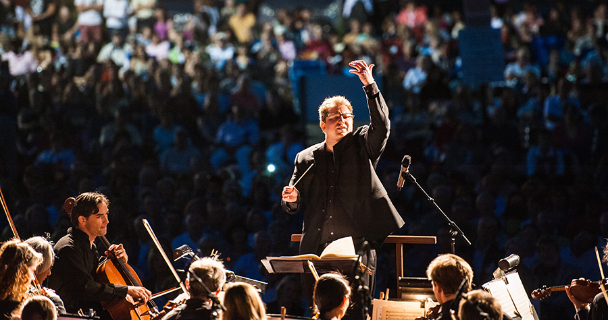
Tying it all together (today)

Slide 33
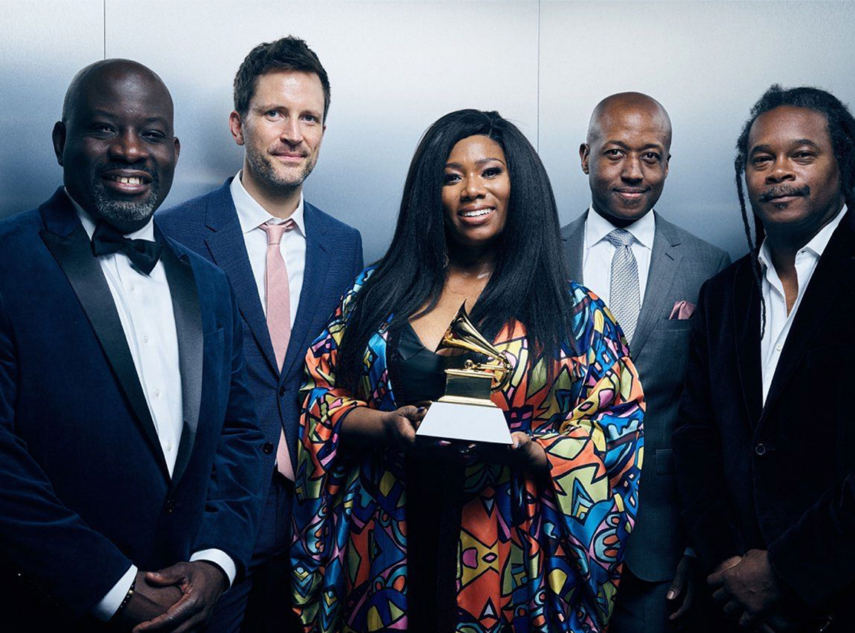
Folk Music & Jazz
Gullah & Folk Music Traditions: Alive & Well
Folk music survives today, and has prominent examples:
“Kum-Ba-Yah”
“Michael Row the Boat Ashore”
Ranky Tanky – keeping native traditions alive
Country, bluegrass and folk music vital elements of the Charleston music scene
Darius Rucker
Jazz:
Charleston Jazz Orchestra – founded 2008
Part of Charleston Jazz with co-founder Jack McCray
Joe Clark Big Band (at Forte Jazz Lounge)
Jazz studies:
College of Charleston
Charleston Jazz Initiative
Avery Research Center

Slide 34
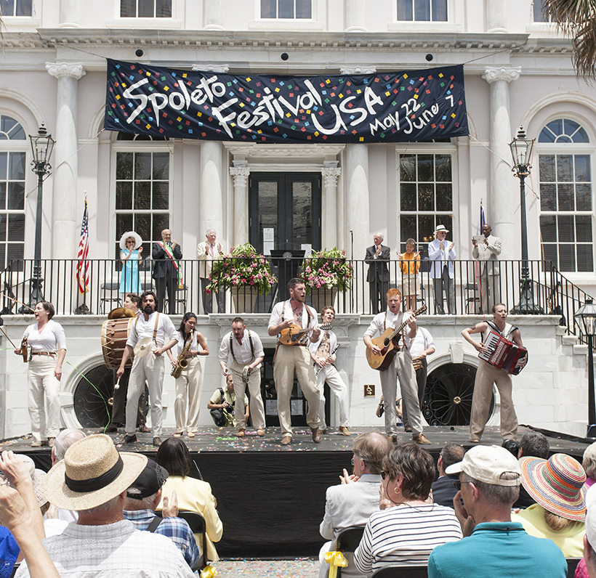
Vibrant, Diverse, Alive
Spoleto Festival – created 1977 by Gian Carlo Menotti
“It will be…a unique and fertile ground for the young, and a diversified home for the masters”
Counterpart of “Festival of Two Worlds” in Italy
Flora (opera) – re-created in 2010 by composer Neely Bruce to mark the renovation of the Dock St. Theater
Opera:
New ventures:
Charleston Opera Theater (2020)
Holy City Arts & Lyric Opera (2020)

Slide 35
Orchestras & Ensembles
Orchestral and European fine music tradition continues
Charleston Symphony – founded 1936
Today, the leading classical ensemble in Charleston with a 24-musician core – similar to its roots
Summerville Orchestra & Mt. Pleasant Symphony
Continue the tradition of professional/amateur Charleston - ensemble tradition
Chamber Music Charleston
Continues a tradition of chamber music that thrived in the 1920s, when salon music was the rage in Charleston

Slide 36
To sum up:
Charleston music today, is very much Charleston music of old
Our past has greatly shaped and influenced our current musical climate
Everyday, respect is paid to the musical tradition that began in the 18th century

Slide 37
Further Reading:
Please email me: conductorwojciech@gmail.com for a full list of resources
Noted sources:
Edmund Thornton Jenkins: The Life and Times of an American Black Composer, 1894-1926. Green, Jeffrey P. 1982. Praeger Publishing, UK.
America’s Music. Chase, Gilbert. 1966. McGraw-Hill Book Company, NY.
The History of Jazz. Gioia, Ted. 1997. Oxford University Press, NY.
Charleston Jazz. McCray, Jack. 2007. Arcadia Publishing, Charleston, SC.
Gershwin: Rhapsody in Blue. Schiff, David. 1997. Cambridge University Press, NY.
https://www.Charlestonjazz.net – The Charleston Jazz Initiative
https://www.sciway.net/south-carolina/jenkins-orphanage.html - Jenkins Orphanage Band

Slide 38
Thank you so much!

