Slide 1
Reflecting on Civic Engagement
Art by Carson Ellis

Slide 2
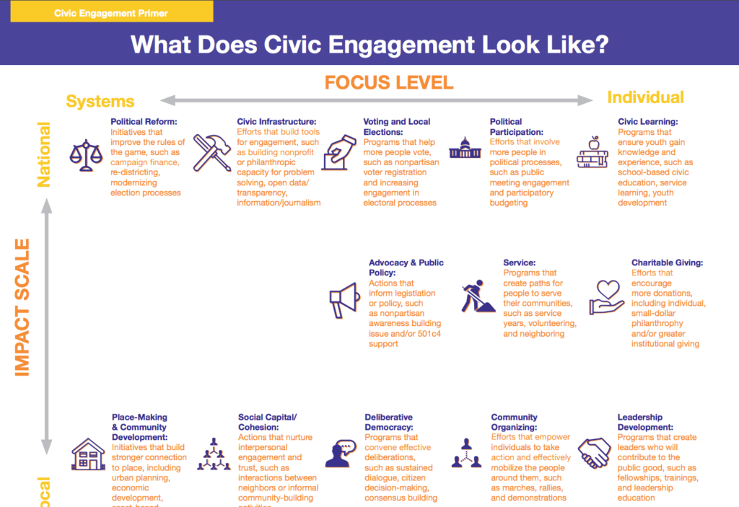
Spectrum of Civic Engagement
Civic engagement can take many forms:
individual voluntarism
organizational involvement
electoral participation
It can include efforts to directly address an issue, work with others in a community to solve a problem or interact with the institutions of representative democracy.
The American Psychological Association
An engaged citizen should have the ability, agency, and opportunity to move comfortably among various types of civic acts.

Slide 3
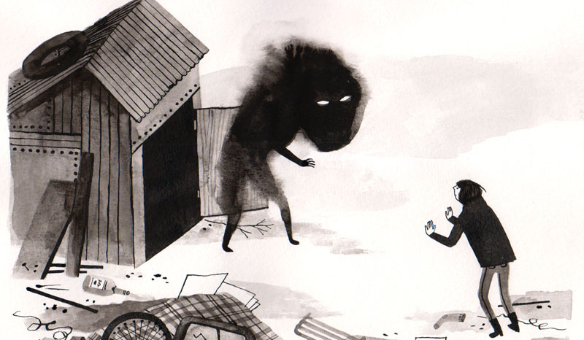
Volunteering and Political Activism
Common perception of volunteers and activists:
Volunteer = Helpful, Caring, Fun, Self-less, Kind-hearted, Free
Activist = Anger, Protest, Bias, Argue, Hippies, Riot
The Politics of Volunteering (2013) by Nina Eliasoph

Slide 4
What do activists actually do?
Treat the problems they aim to fix as issues of justice
1
Expand the domain of political, conscious, democratic decision-making.
2
Often operate outside of routine channels.
4
Move issues from private to public – demand that people reflect on issues
3
The Politics of Volunteering (2013) by Nina Eliasoph

Slide 5
Striking a Balance
“However hard it is to connect volunteering to politics, disconnecting them might be more risky.”
“Volunteering sometimes becomes more convincing, and therefore, more inspiring when connected to politics.”
“Activism can sometimes become more emotionally real to people when it is connected to volunteering.”
The Politics of Volunteering (2013) by Nina Eliasoph

Slide 6
Asking to be Perplexed
Democratic inquiry doesn’t have an end; there is no final solution. Democracy is an experiment…It’s an endless spiral of change and inquiry that produces more change that produces more inquiry.
The Politics of Volunteering (2013) by Nina Eliasoph

Slide 7
What is reflection?
A process which:
Deepens learning
Connects experience to course material
Explores the application and integration of knowledge, problem-solving skills, and cognitive development
What do we most need to know about the impact of service-learning on student learning by Janet Eyler (2000)

Slide 8
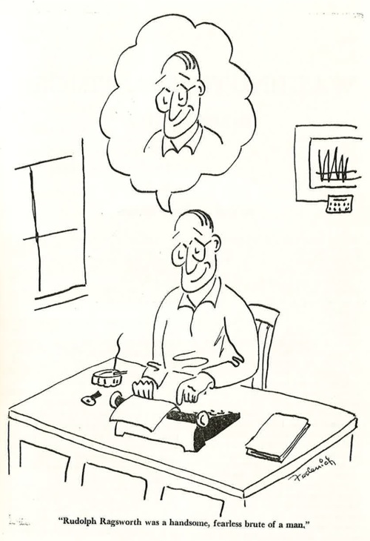
What it ain’t—
Vague
Superficial
Haphazard
AVOID:
“I learned a lot…”
“I got so much out of my experience…”
“I enjoyed…”

Slide 9
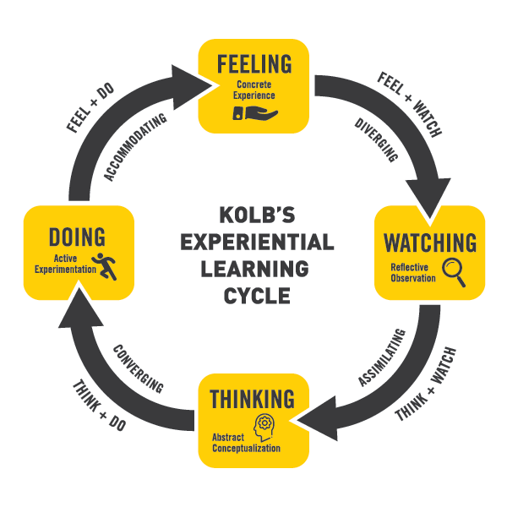
Articulated Learning
Explores decisions made and actions taken in light of consequences for the common good
Considers alternative approaches and interpretations
Identifies elements of power and privilege
Analyzes options for short-term versus long-term and sustainable change.
The Articulated Learning: An Approach to Guided Reflection and Assessment by Sarah L. Ash and Patti H. Clayton (2004)

Slide 10
Find a partner!
Learn:
Name
Honors Engaged Project
One thing they have learned in their project
Why it matters

Slide 11
Honors Engaged First-Semester Reflection
Please compose a series of paragraphs addressing each of the following five questions regarding your Honors Engaged experience thus far.
What did I learn?
How, specifically, did I learn it?
Why does this learning matter? How is it significant?
In what ways will I use this learning? What goals shall I set in accordance with what I have learned in order to improve myself, the quality of my learning, or the quality of my future service?
What measurable impact do I imagine making on the Charleston community in the future as a result of this learning?
What else do I hope to learn going forward?

Slide 12
Connecting Theory to Practice

Slide 13
The best articulated learning:
Consistently avoids typographical, spelling, and grammatical errors.
Makes statements of fact that are accurate, supported with evidence.
Addresses the complexity of the experience.
Gives meaningful consideration to alternative points of view.
Demonstrates a line of reasoning that is logical, with conclusions or goals that follow clearly.
Draws conclusions and sets goals that address at least one major issue raised by the experience.

Slide 14
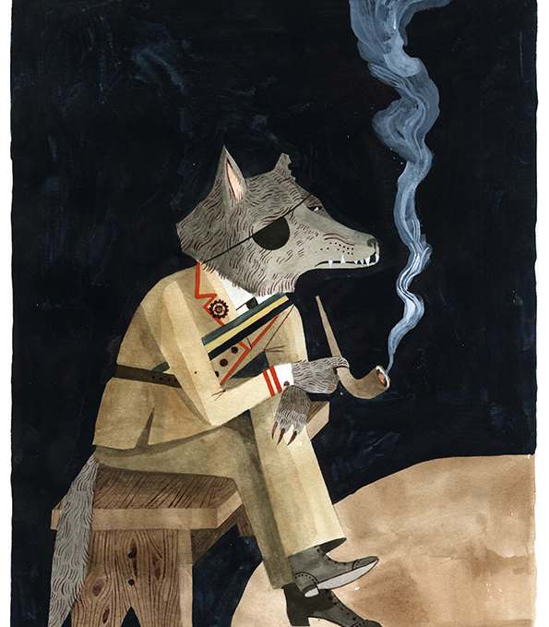
Articulated Learning Is Critical Thinking
Critical Thinking is a systematic way to form and shape one’s thinking. . . . It is thought that is disciplined, comprehensive, based on intellectual standards, and as a result, well-reasoned”
Critical thinking: What every person needs to survive in a rapidly changing World by Richard Paul (1993)

Slide 15
I learned that developing a careful balance between idealistic and self-serving motives amongst group members is essential in meeting collective objectives. There is a danger associated with trading off “ideal” motives for lesser ones (as acceptance of these motives could lead to less beneficial results), although at the same time unmet objectives will likely result from a leader’s unwillingness to work with each individual’s motives.
Adapted from The Articulated Learning: An Approach to Guided Reflection and Assessment by Sarah L. Ash and Patti H. Clayton (2004)

Slide 16
I learned this when the students have thus far been unreceptive to our group’s attempts to persuade them that this project should be about the learning and growth they experience (idealistic motives), rather than the grade they receive. I do not want to allow the students to settle for just receiving a grade from their projects. I realized even with these perhaps self-serving motives, the learning community can still receive tangible benefits that will certainly not be met if our group refuses to motivate the students with a grade, what currently matters to them.
Adapted from The Articulated Learning: An Approach to Guided Reflection and Assessment by Sarah L. Ash and Patti H. Clayton (2004)

Slide 17
This learning matters because individuals working together in a group will always have slightly different (and often self-serving) motives for participation in that group, and although a common vision may be somewhat present, there are still discrepancies in each member’s idea of an ideal end-state. In a leadership role, I must be willing to understand that every member may not be involved for the same reasons
Adapted from The Articulated Learning: An Approach to Guided Reflection and Assessment by Sarah L. Ash and Patti H. Clayton (2004)

Slide 18
In light of this learning, I will recognize the need to harness motives, both idealistic and more self-serving, for the common good, yet at the same time seek to focus mainly on idealistic motivation to the extent that my group members can handle.
Adapted from The Articulated Learning: An Approach to Guided Reflection and Assessment by Sarah L. Ash and Patti H. Clayton (2004)

Slide 19
First Semester Reflections due in final portfolio
Honors Engaged resumes in the Spring—plan your schedule accordingly
Reflection is an ongoing process!
Meetings with project liaisons in the spring

